Slide 1
Copyright © 2009 MES-English.com

Slide 2
St. Valentine’s Day

Slide 3
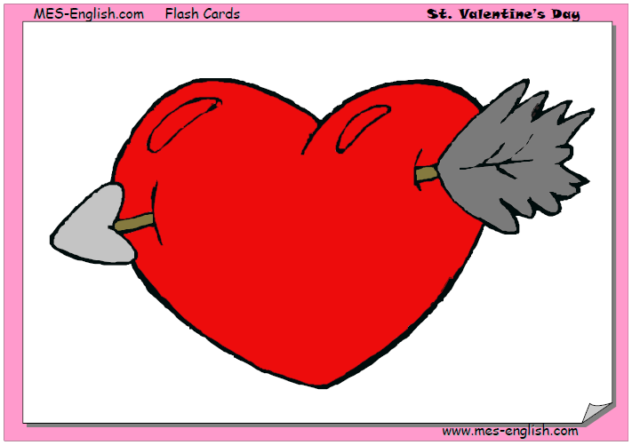
a heart

Slide 4

Happy Valentine’s Day!

Slide 5
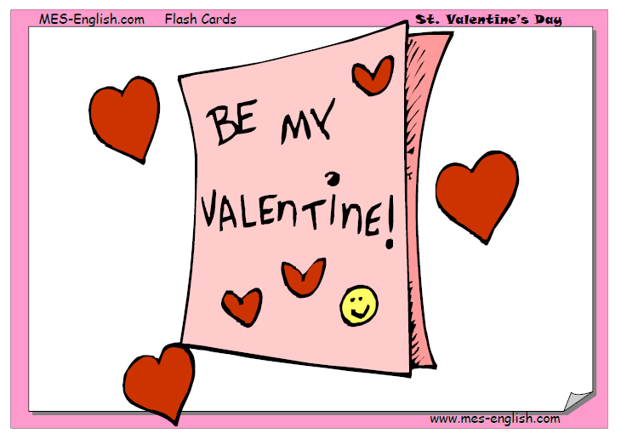
a valentine

Slide 6
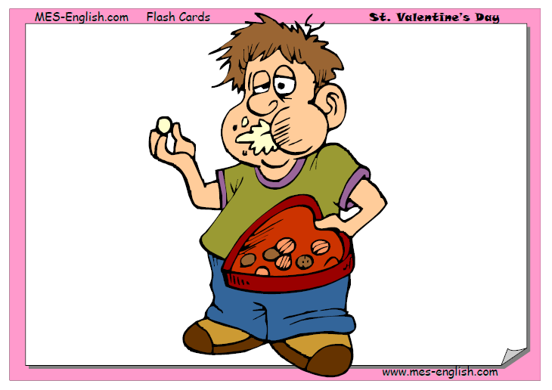
a box of chocolates

Slide 7
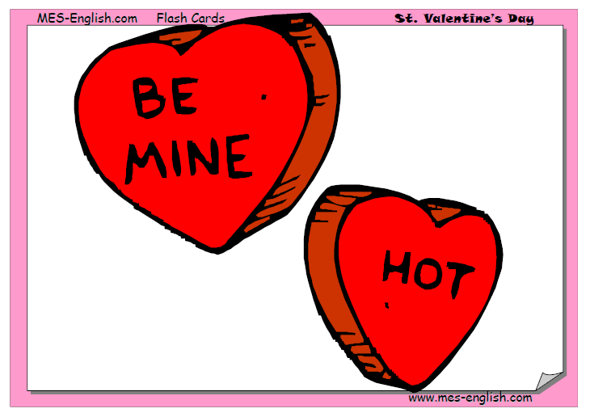
candy hearts

Slide 8
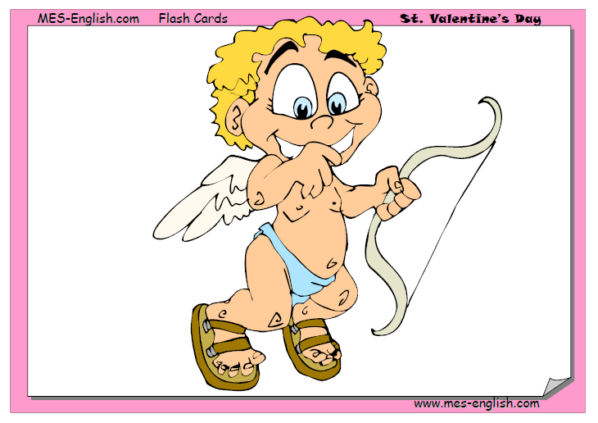
Cupid

Slide 9
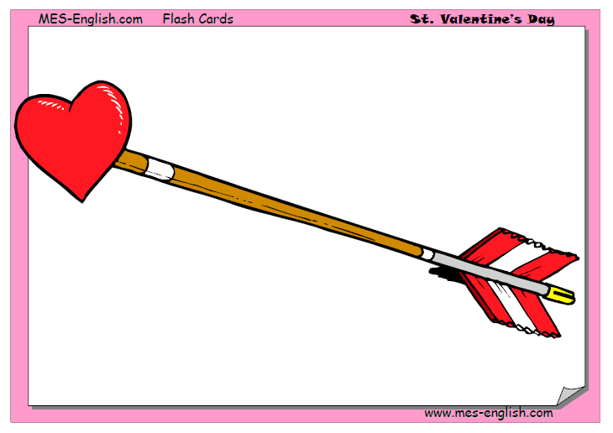
an arrow

Slide 10
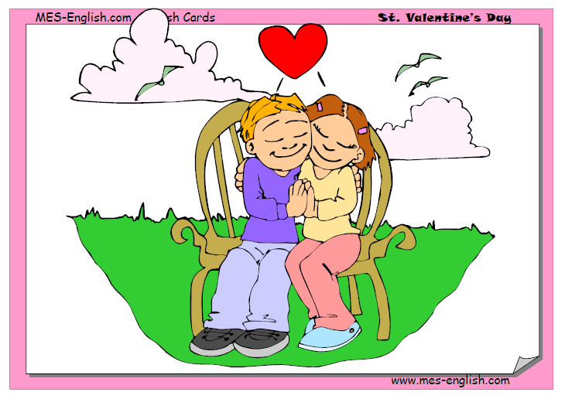
a date

Slide 11
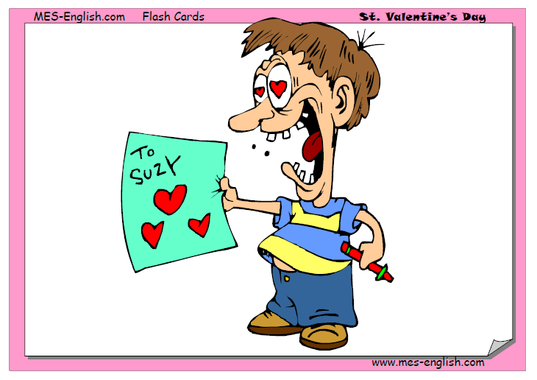
writing a valentine

Slide 12
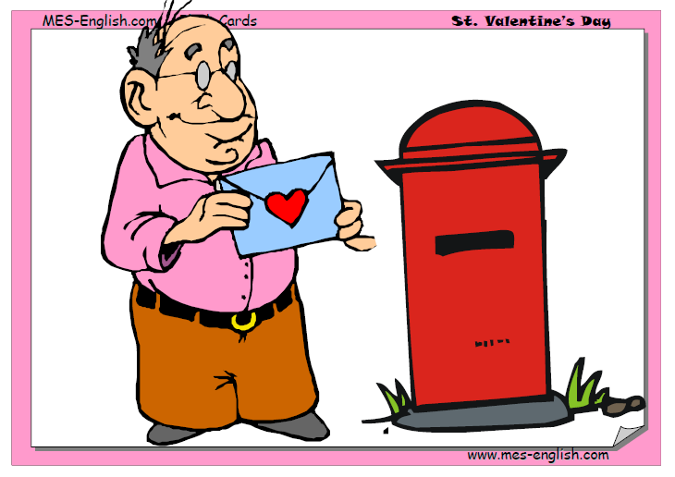
sending a valentine

Slide 13
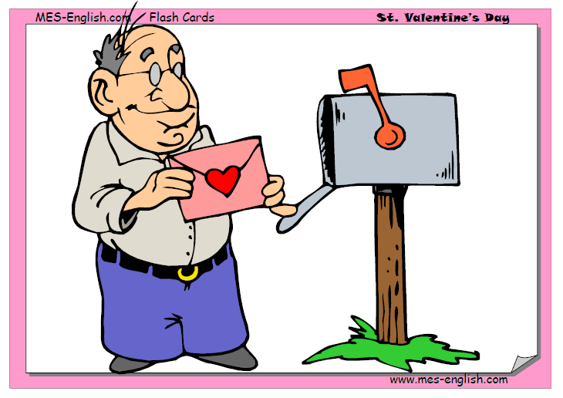
getting a valentine

Slide 14
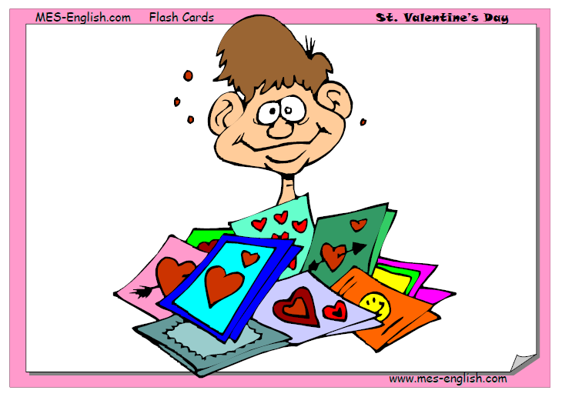
popular

Slide 15
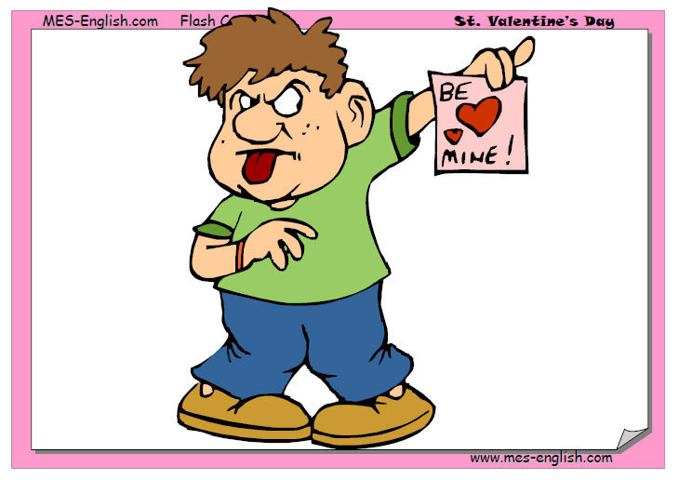
gross

Slide 16
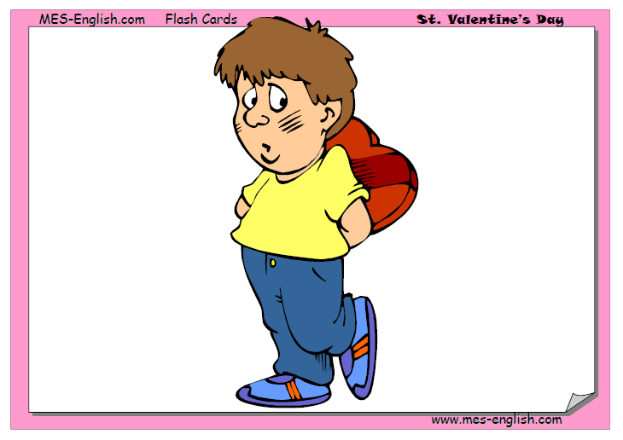
embarrassed

Slide 17
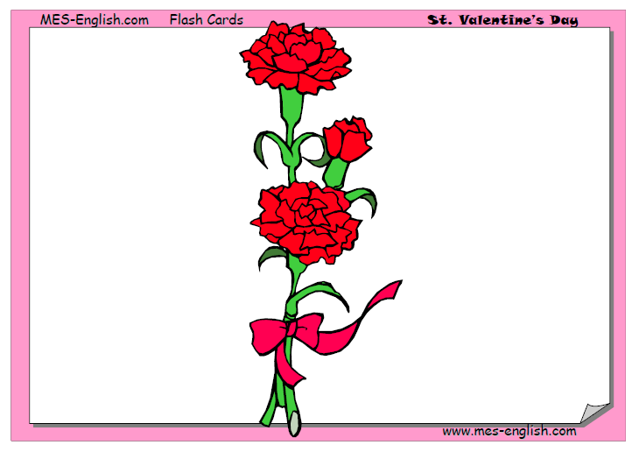
carnations

Slide 18
love-struck

Slide 19
a rose

